Slide 1
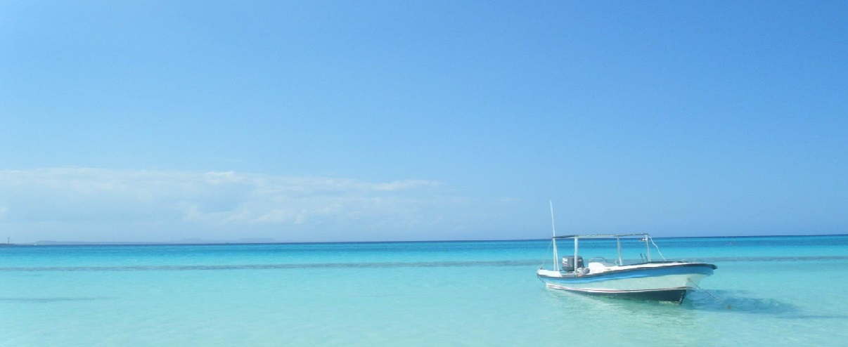
SHIP RESERVATION SYSTEM
By:-
Kaustab Paul
Snigdha Phadke
Aaditaya Aasish
Sruti Sen
Project Guide:
Ms. Alka Jhanwar

Slide 2
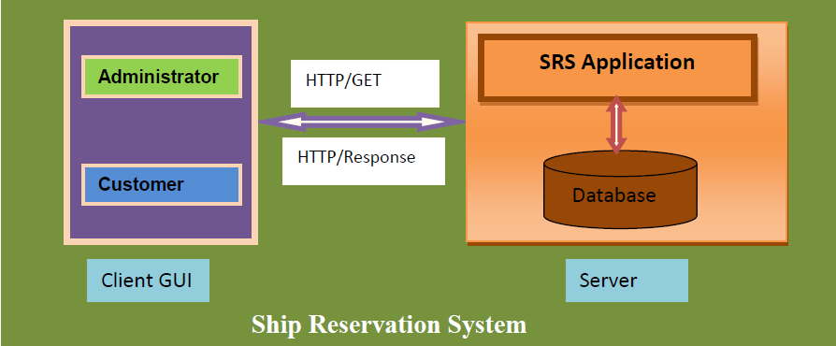
INTRODUCTION
This project has been developed using Java/J2EE and Oracle database
The Ship Reservation System supports basic functionalities for 2 types of users-Administrator (A) and Customer (C) wherein all users need to login successfully before performing any of their respective operations.

Slide 3
Software Requirements
JAVA platform (runtime environment)
Spring , Hibernate, JARs
Oracle 10G/11G
HTML5 support for browsers
Hardware Requirements
Hard disk memory required: : 5 GB
RAM : 1GB or higher is preferable

Slide 4
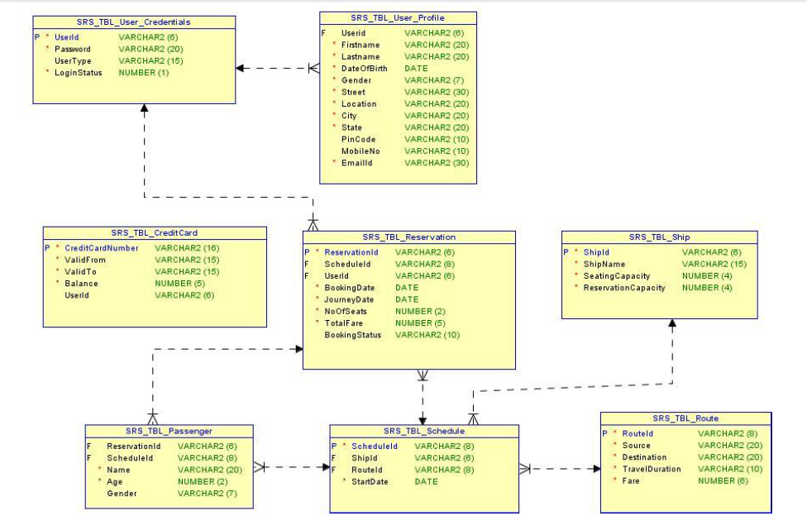
Table Structures for the Project

Slide 5
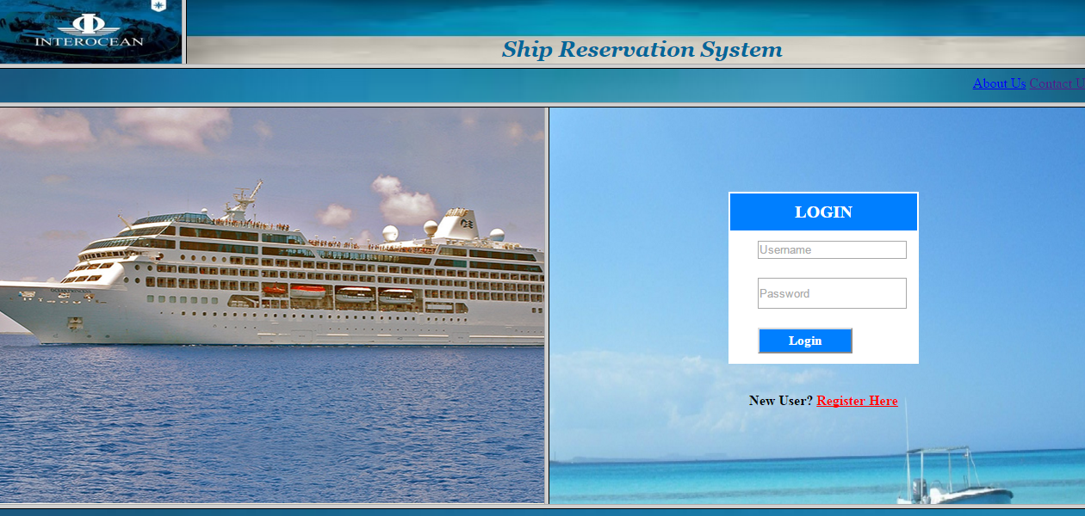
Home Page

Slide 6
BASIC FUNCTIONALITIES OF ADMIN
The functions which an admin can perform are:
Login
Change password
Add/Modify/Delete/View Ship details
Add/Modify/Delete/View Schedule details
Add/Modify/Delete/View Route details
View Passenger details for a particular ship on a particular date
Logout

Slide 7
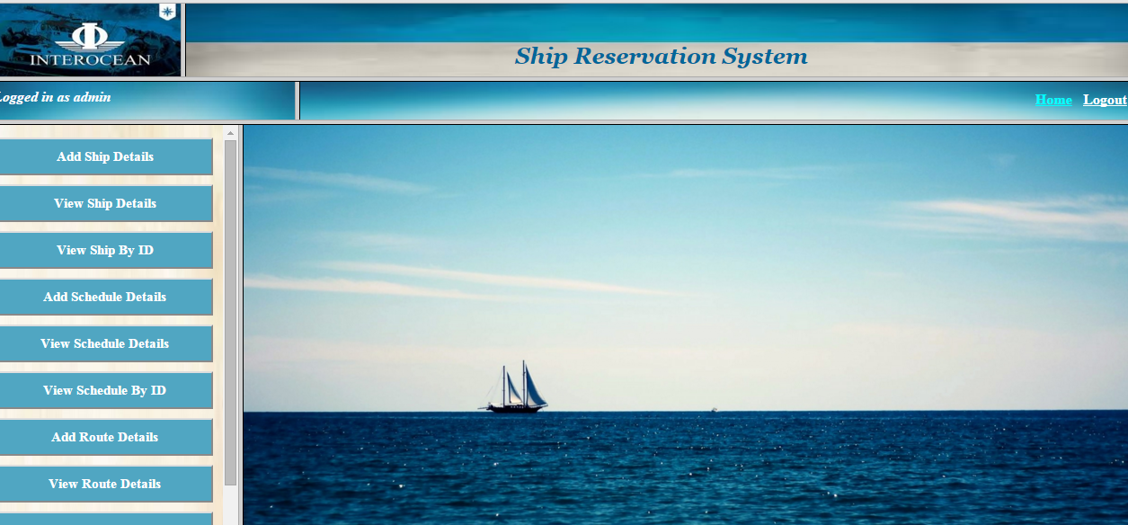
Admin Home Page

Slide 8
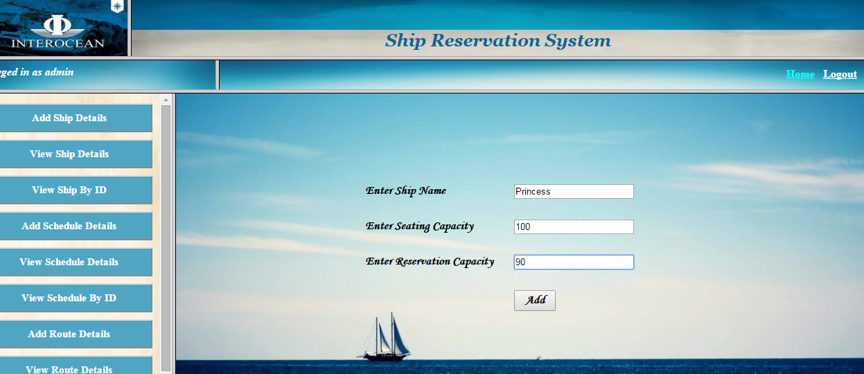
Add Ship Details

Slide 9
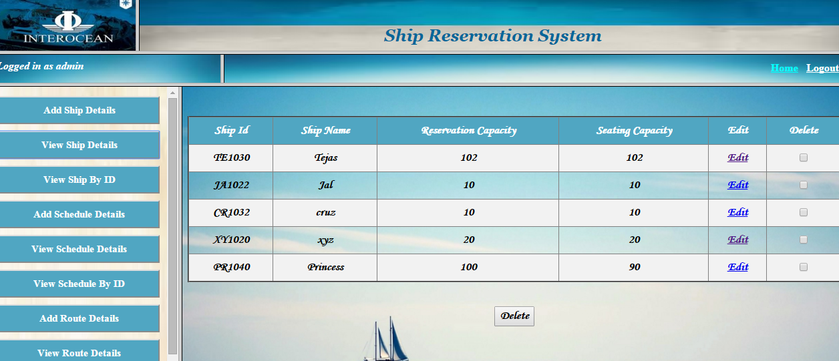
View Ship Details

Slide 10
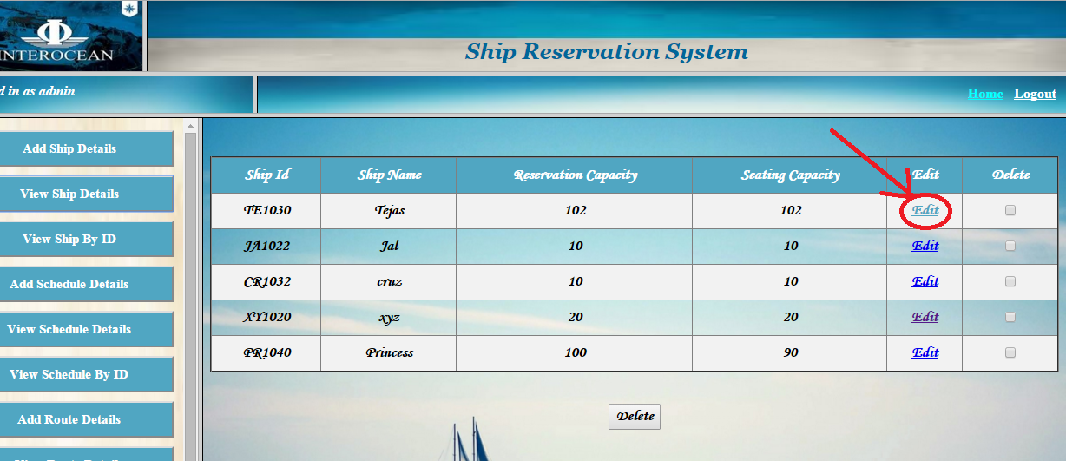
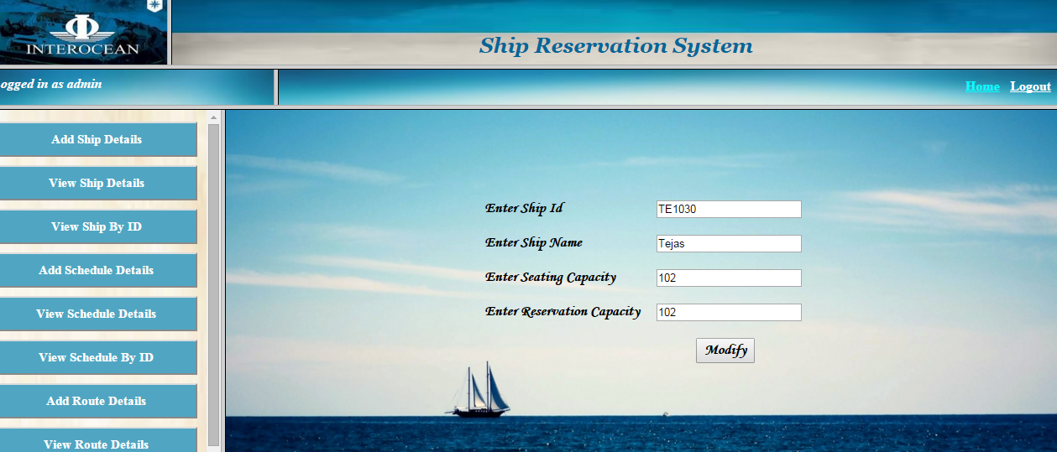
Modify Ship Details

Slide 11
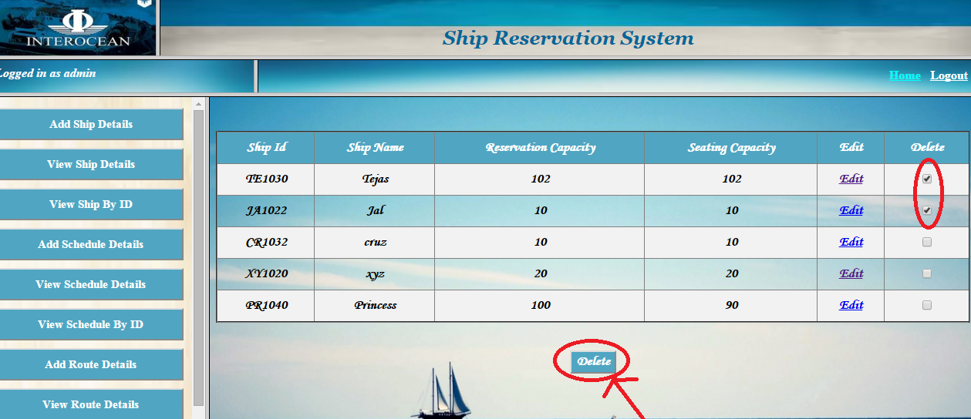
Delete Ship(s)

Slide 12
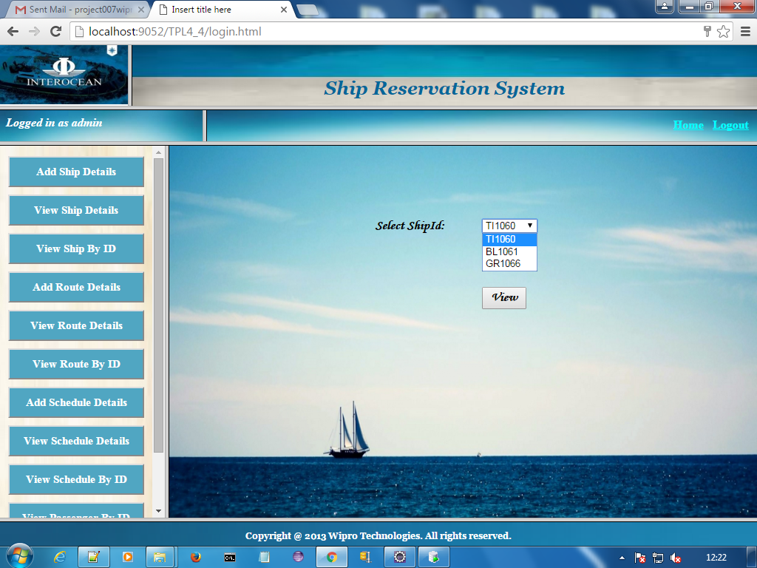
View Ship By ID

Slide 13
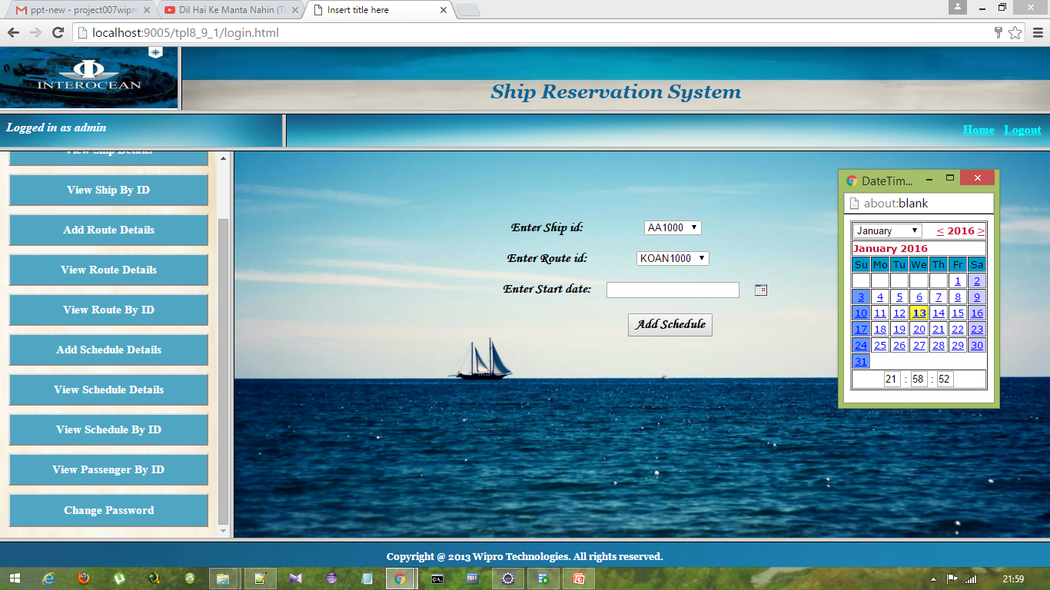
Add Schedule

Slide 14
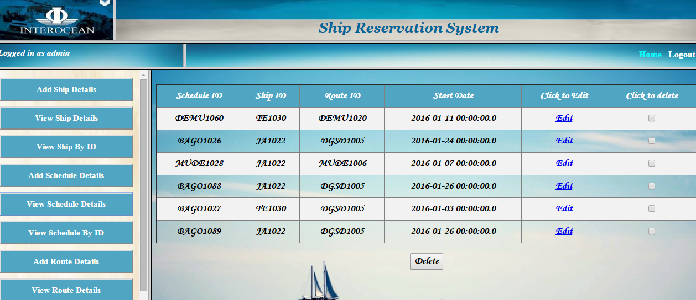
View Schedule Details

Slide 15
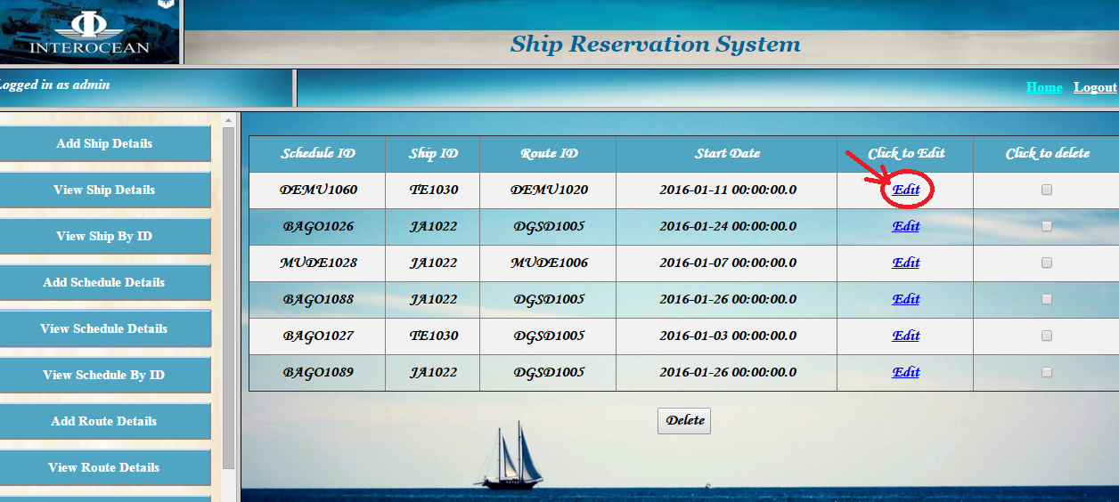
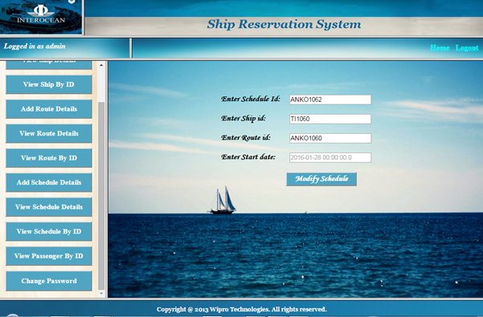
Modify schedule details

Slide 16
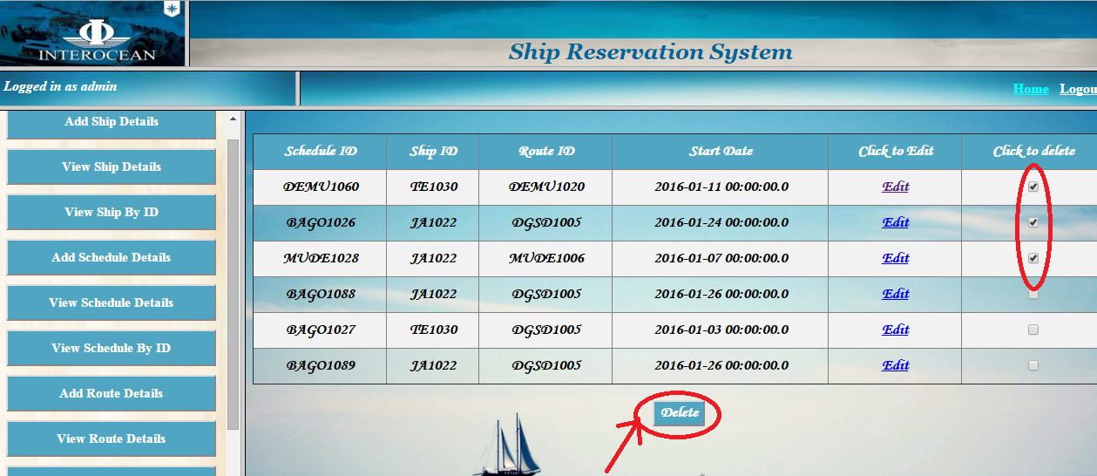
Delete Schedule details

Slide 17
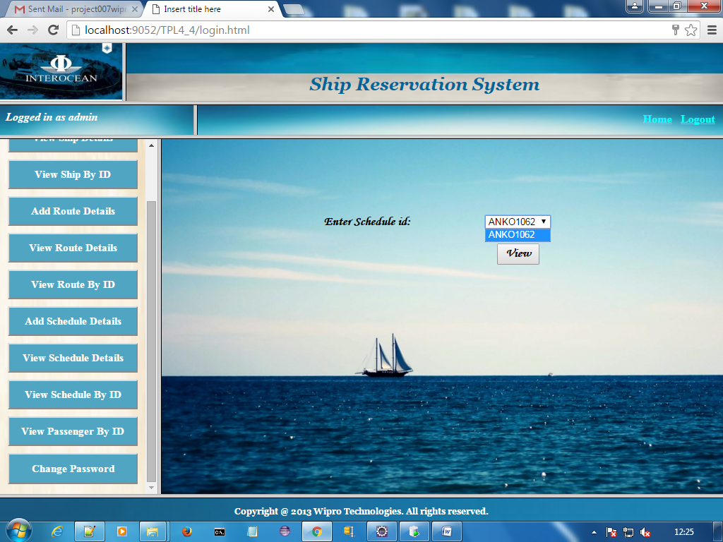
View Schedule By ID

Slide 18
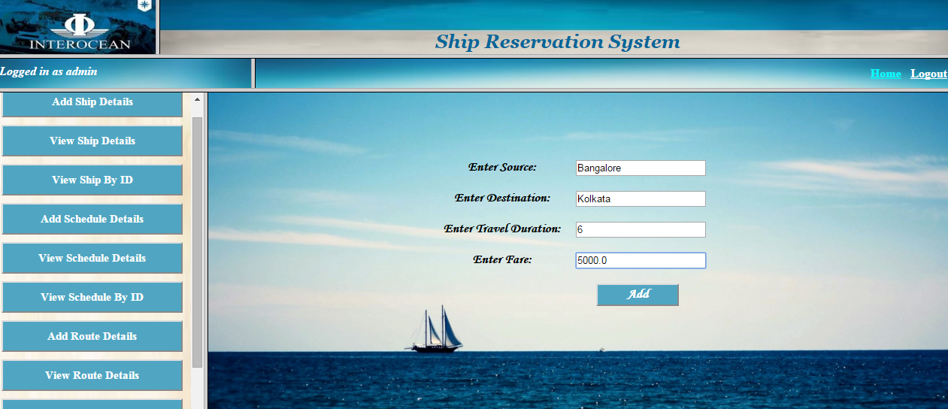
Add Route details

Slide 19
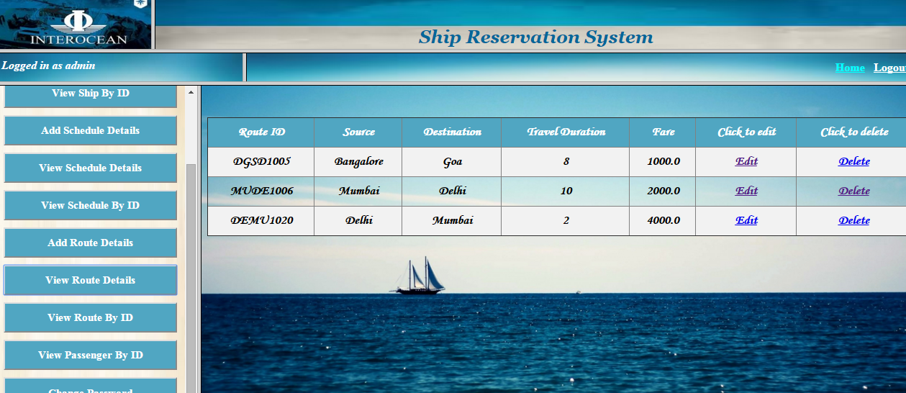
View Route details

Slide 20
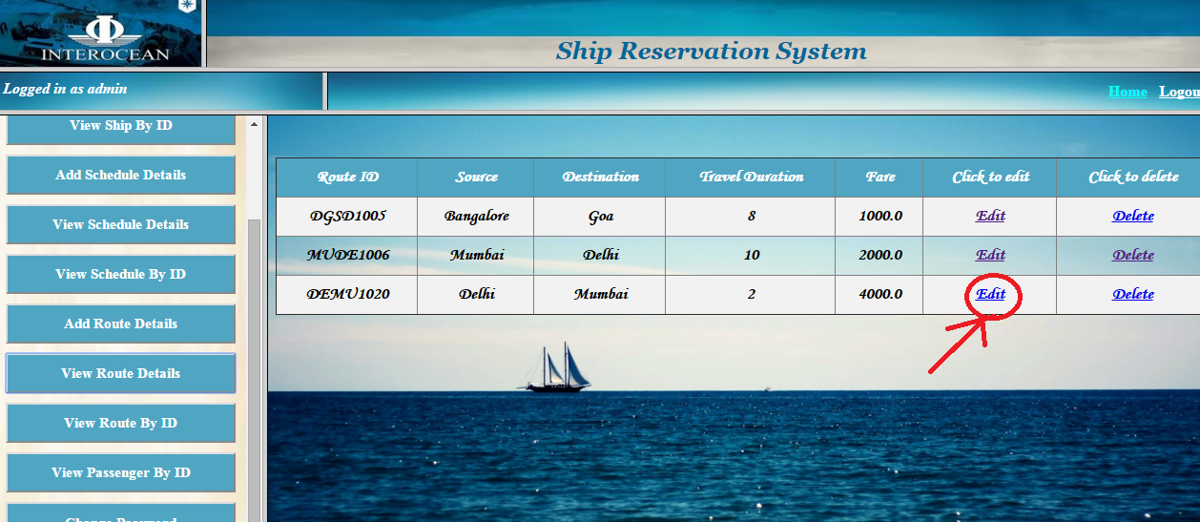
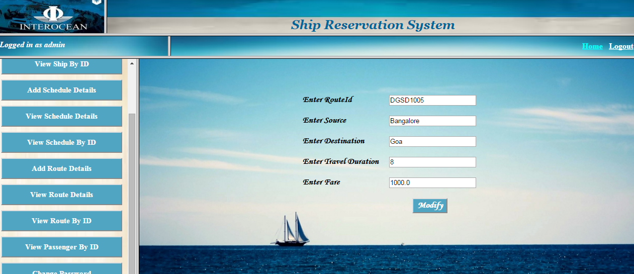
Modify Route details

Slide 21

Delete Route details

Slide 22
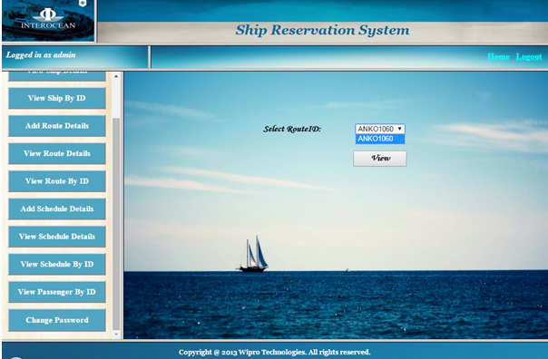
View Route By ID

Slide 23
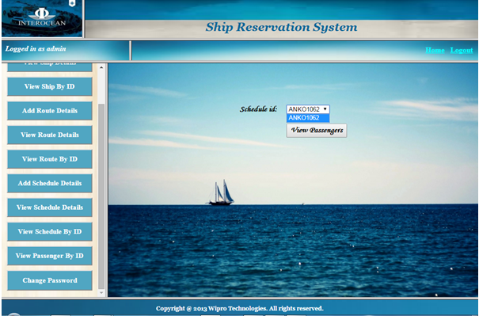
View Passengers by
Schedule ID

Slide 24
BASIC FUNCTIONALITIES OF CUSTOMER
The operations which a customer can perform are:
Registration
Login
Change password
View Ship details
View Schedule details
Reserve ship tickets
Cancel ticket
View ticket
Print ticket
Logout

Slide 25
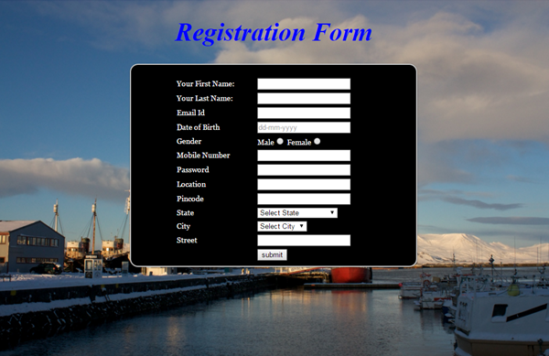
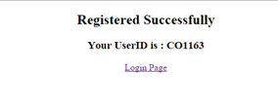
Customer Registration
User ID generation

Slide 26
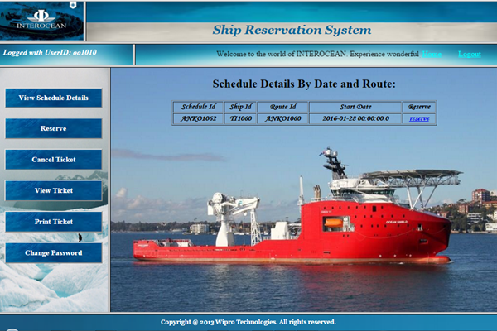
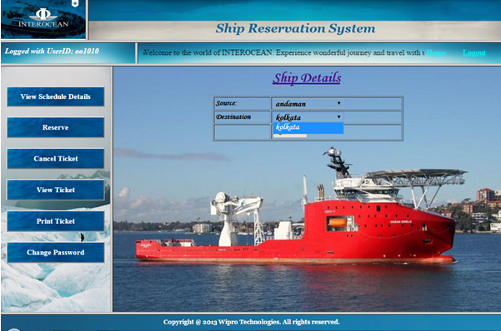
View Schedule details

Slide 27
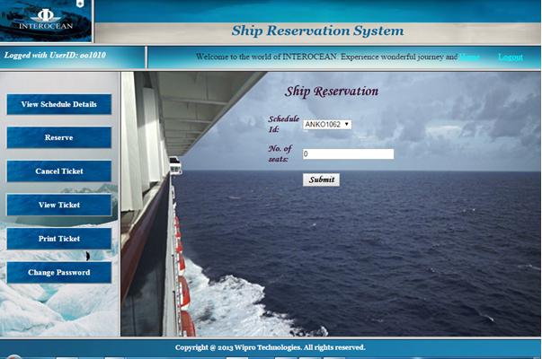
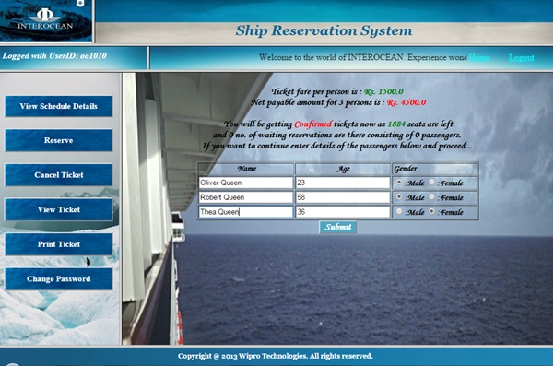
Reserve tickets for Customer
Customer entering passenger details

Slide 28

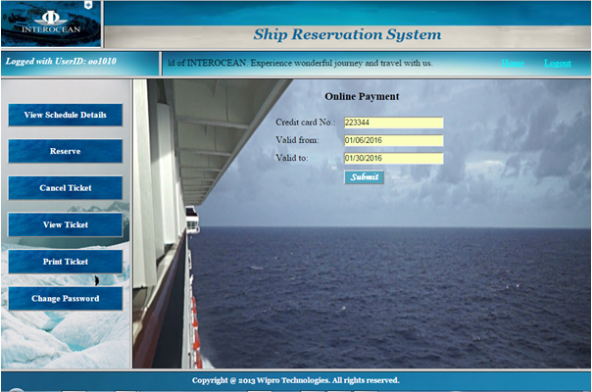
Online Payment

Slide 29
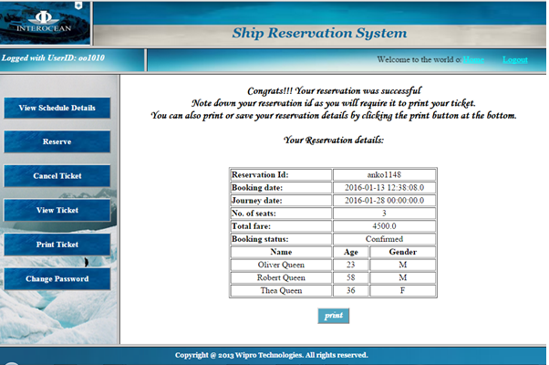
View ticket before printing

Slide 30
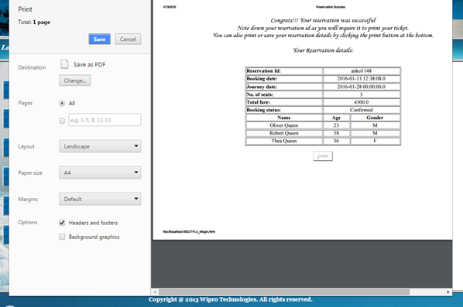
Print Ticket

Slide 31
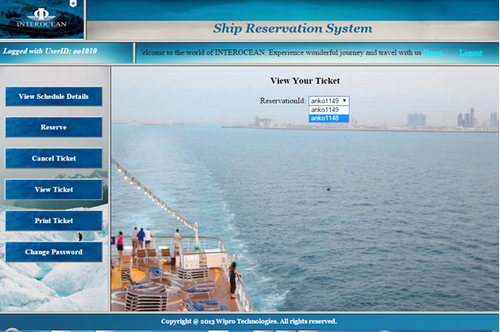
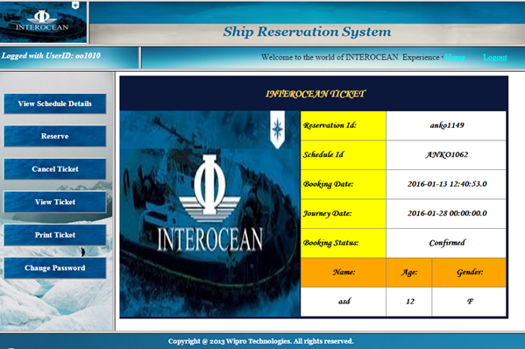
Enter Reservation ID to View Ticket

Slide 32
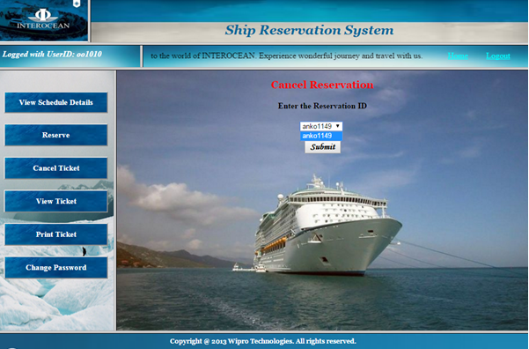
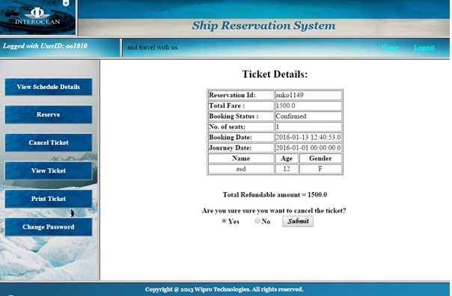
Ticket Cancellation

Slide 33
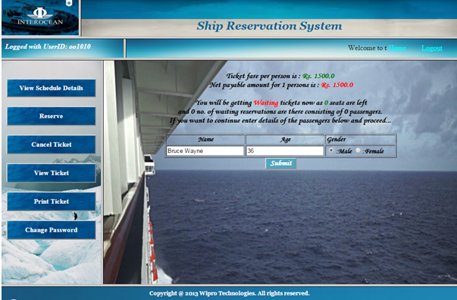
Reservation in waiting list

Slide 34
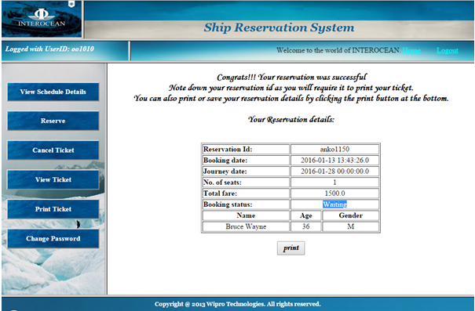
Print Ticket for waiting list

Slide 35
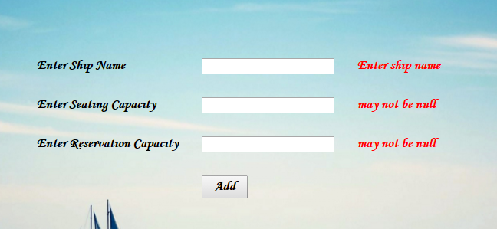
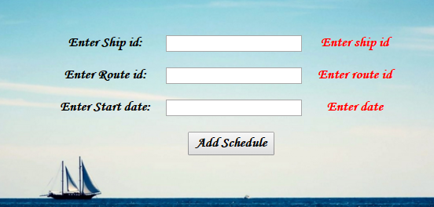
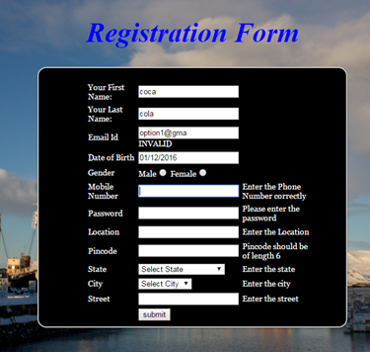
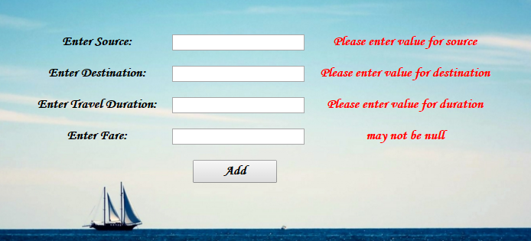
Validations

Slide 36
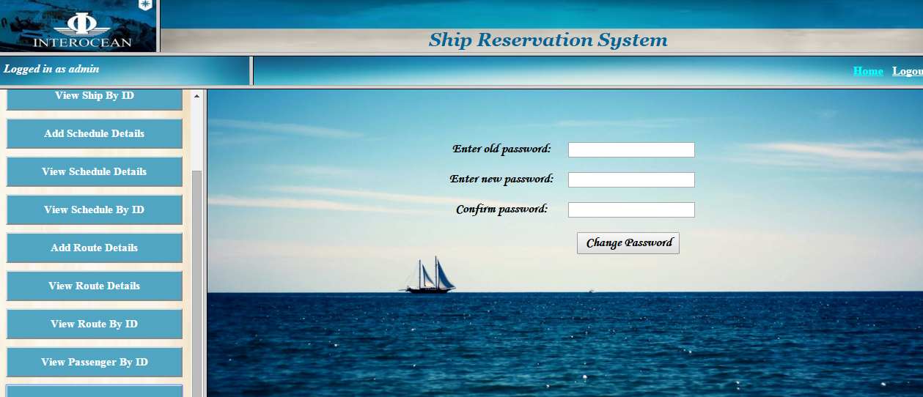
Change password

Slide 37

Logout Page

Slide 38
Limitations and future scopes:
1. Waiting list is based on simple FIFO basis and they will get confirmed according to the no. of seats required in each reservation on cancellation.
2. If a reservation contains more than free seats all will go to waiting list.
3. Not thread-safe.

Slide 39
Thank you

